Slide 1
A comparison of the Linux and Windows Device Driver Architectures by Melekam Tsegaye, Richard Foss
Presented by Shuowen Wei

Slide 2
Abstract and Introduction
Linux and Windows operating systems

Slide 3
Organization
General driver architecture of the two OS
Driver architecture components of each OS
Implementation of a Driver that performs I/O to a kernel buffer
Driver development environments and facilities offered by the two OS to dvelopers

Slide 4
Organization
General driver architecture of the two OS
Driver architecture components of each OS
Implementation of a Driver that performs I/O to a kernel buffer
Driver development environments and facilities offered by the two OS to dvelopers

Slide 5
Windows Driver Architecture
Two types
Legacy drivers (outdated)
Plug and Play drivers (PnP)
Advantages of PnP drivers
User friendly (little effort is required from user to install them)
Loaded only when OS needs (save system resources)

Slide 6
Windows Driver Model(WDM)
WDM is a standard model specified by Microsoft. WDM drivers are usable on all of MS’ recent OS (W95 and later)
Three classes of WDM:
Filter
Functional
Bus drivers
WDM must be PnP aware, support management and windows management instrumentation

Slide 7
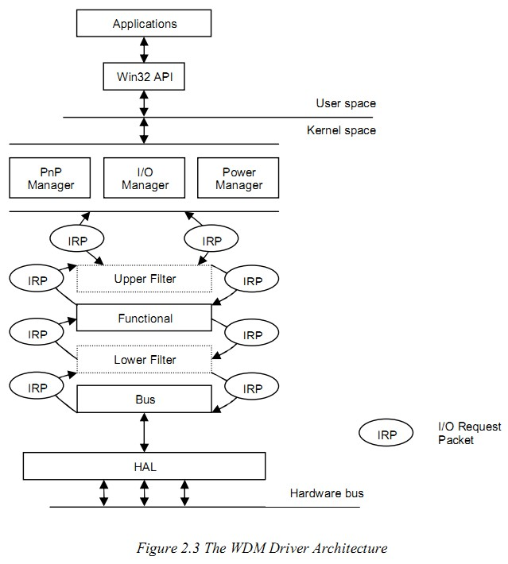
I/O Request Packet (IRP) is used for communication between driver layers
Not every IPR filers down to a bus driver
Some IRPs get handled by the layers above and are returned to the I/O managers
Hardware access to a device is done through a hardware abstraction Layer (HAL)

Slide 8
Linux Driver Architecture
Drivers in Linux are represented as modules, which are pieces of code that extend the functionality of the Linux kernel.
Using function calls for communications between modules.
At load time a module exports all functions it wants to make public to a symbol table that the Linux kernel maintains. (visible to all modules)

Slide 9
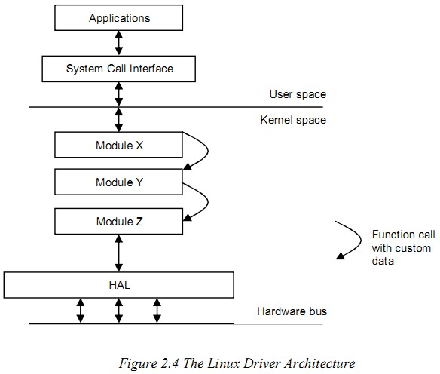
Linus use function calls to communicate between Modules (drivers)

Slide 10
Similarities in Driver Architecture
In both systems, drivers are modular components that extend the functionality of the kernel, can be loaded into a kernel at runtime
Each module contains an entry point that kernel knows to start code execution from.

Slide 11
Differences in Drive Architectures
Windows use IRPs to communicate between layers, while Linux use function calls between modules.
Windows has separate kernel components that manage PnP, I/O, and Power; Linux has no clearly distinction between modules.

Slide 12
Organization
General driver architecture of the two OS
Driver architecture components of each OS
Implementation of a Driver that performs I/O to a kernel buffer
Driver development environments and facilities offered by the two OS to dvelopers

Slide 13
Drive Architecture Components (Windows)
Driver Initialization
The AddDevice Routine
Creating a device object
Global Driver Data
Device naming
Driver Access from an Application
Device Object Stacking
User to Kernel and Kernel to User Data Transfer Modes in Windows
Dispatch Routines
Windows Driver Installation
Obtaining Driver Usage Information in Windows

Slide 14
Drive Architecture Components (Windows)
Driver Initialization
The AddDevice Routine
Creating a device object
Global Driver Data
Device naming
Driver Access from an Application
Device Object Stacking
User to Kernel and Kernel to User Data Transfer Modes in Windows
Dispatch Routines
Windows Driver Installation
Obtaining Driver Usage Information in Windows

Slide 15
Driver Initialization (Windows)
DriverEntry, first routine to be executed
Driver object represents currently loaded kernel drivers whereas also represents a physical, logical or virtual device
Currently loaded driver: Function Device Object (FDO)
Lower driver: Physical Device Object (PDO) (back to 20)
Upper driver: Filter Device Object (FDO)

Slide 16
Drive Architecture Components (Windows)
Driver Initialization
The AddDevice Routine
Creating a device object
Global Driver Data
Device naming
Driver Access from an Application
Device Object Stacking
User to Kernel and Kernel to User Data Transfer Modes in Windows
Dispatch Routines
Windows Driver Installation
Obtaining Driver Usage Information in Windows

Slide 17
The AddDevice Routine (Windows)
if it is a PnP driver
Creating a device object
Use IocreateDevice routine for:
a name of device (gain a handle to the driver)
device type (specify the purpose of driver, e.g. storage device)
Global Driver Data
DeviceExtension (store driver data, eliminates the need to use global data in driver code)
Device naming
At device object creation time, for accessing a handle to a driver (a handle is used for performing I/O)
No naming protocol, may clash if two have the same name, thus MS supports Device interfaces, 128-bit globally unique identifiers (GUIDs), can be publicised

Slide 18
The AddDevice Routine (Windows)
Driver Access from an Application
For named devices:
Application can obtain a handle to a device through CreateFile Win32 API call, require a path such as \\device\devicexxx, devicexxx is the device name and the previous is the path
CreateFile can also requires access mode flags such read, write and file sharing for the device
For unnamed devices (already registered a device interface):

Slide 19
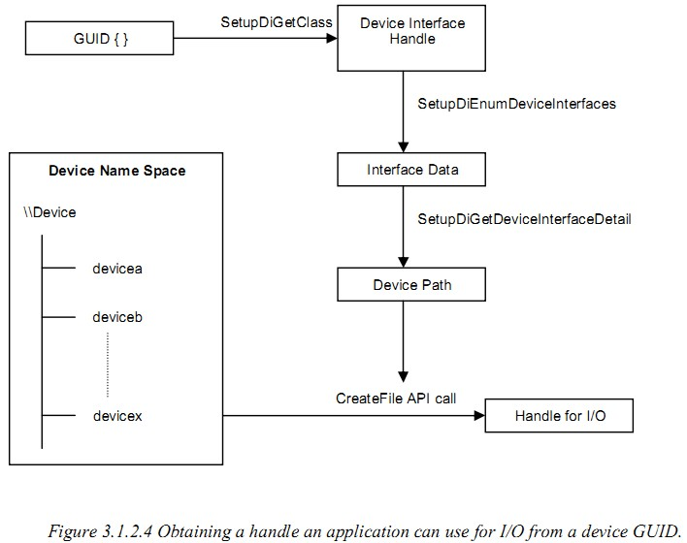
The AddDevice Routine (Windows)
Application access an unnamed device

Slide 20
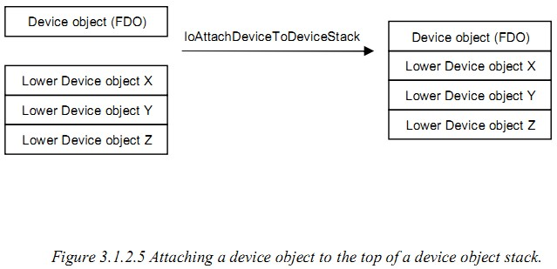
The AddDevice Routine (Windows)
Device Object Stacking (PDO is required)

Slide 21
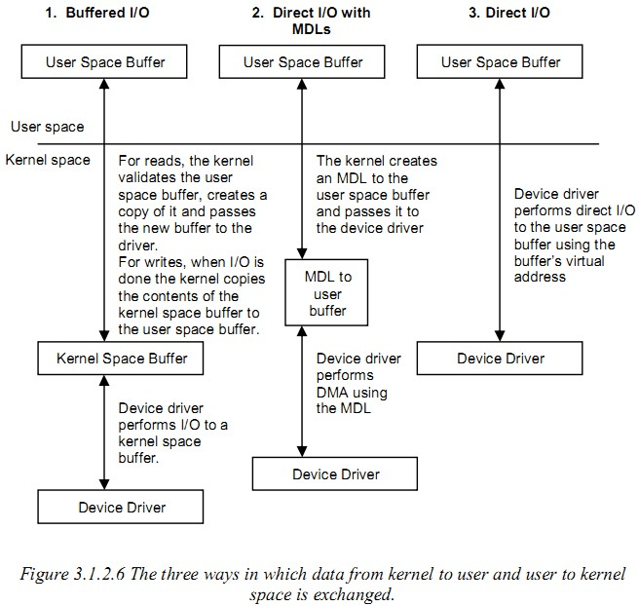
User to Kernel and Kernel to User Data Transfer Modes in Windows

Slide 22
Drive Architecture Components (Windows)
Driver Initialization
The AddDevice Routine
Creating a device object
Global Driver Data
Device naming
Driver Access from an Application
Device Object Stacking
User to Kernel and Kernel to User Data Transfer Modes in Windows
Dispatch Routines
Windows Driver Installation
Obtaining Driver Usage Information in Windows

Slide 23
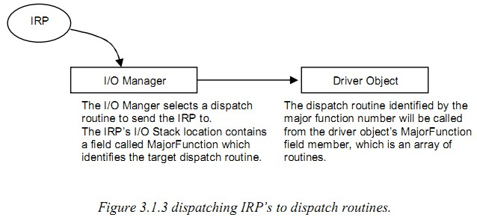
Dispatch Routines (Windows)
Dispatch Routines (Handle incoming IRPs)

Slide 24
Drive Architecture Components (Windows)
Driver Initialization
The AddDevice Routine
Creating a device object
Global Driver Data
Device naming
Driver Access from an Application
Device Object Stacking
User to Kernel and Kernel to User Data Transfer Modes in Windows
Dispatch Routines
Windows Driver Installation
Obtaining Driver Usage Information in Windows

Slide 25
Windows Driver Installation
Driver installation information contained in INF file, generated by a GUI application called GenInf.
Hardware and PnP-aware device must be specified in the INF fine since it will be used by the system to identify the device when it’s inserted into the system.

Slide 26
Drive Architecture Components (Windows)
Driver Initialization
The AddDevice Routine
Creating a device object
Global Driver Data
Device naming
Driver Access from an Application
Device Object Stacking
User to Kernel and Kernel to User Data Transfer Modes in Windows
Dispatch Routines
Windows Driver Installation
Obtaining Driver Usage Information in Windows

Slide 27
Obtaining Driver Usage Information in Windows
The device manager found in the control panel system applet provides driver information for uses, lists all currently drivers

Slide 28
Drive Architecture Components (Linux)
Driver Initialization
Device naming
File operations
How Driver Major Minor Numbers work
User to Kernel and Kernel to User Data Transfer Modes in Linux
Linux Driver Installation
Obtaining Driver Usage Information in Linux

Slide 29
Drive Architecture Components (Linux)
Driver Initialization
Device naming
File operations
How Driver Major Minor Numbers work
User to Kernel and Kernel to User Data Transfer Modes in Linux
Linux Driver Installation
Obtaining Driver Usage Information in Linux

Slide 30
Driver Initialization (Linux)
Kernel defined macros:
module_init: register routine, first executed when a driver is loaded
register_chrdev: kernel character device registration routine, in order to set a name for driver, a driver major number and a set of routines for performing file operations
unregister_chrdev: with a device name and major number
module_exit: deregister routine, when driver is being unloaded (cleanup operations)

Slide 31
Drive Architecture Components (Linux)
Driver Initialization
Device naming
File operations
How Driver Major Minor Numbers work
User to Kernel and Kernel to User Data Transfer Modes in Linux
Linux Driver Installation
Obtaining Driver Usage Information in Linux

Slide 32
Device naming (Linux)
Device major numbers (device handle), range: 0~255, assigned to well known devices
Device minor numbers (driver-managed), range: 0~255
Possible for application to gain access up to 65535 devices
Major 250-254 available for experimental use
Major 0 is reserved for null device

Slide 33
Drive Architecture Components (Linux)
Driver Initialization
Device naming
File operations
How Driver Major Minor Numbers work
User to Kernel and Kernel to User Data Transfer Modes in Linux
Linux Driver Installation
Obtaining Driver Usage Information in Linux

Slide 34
File operations (Linux)
Dispatch routines are known as file operations in Linux, and are represented by a structure called file_opertions
File operations are specified during driver registration, a structure called file is created by the kernel whenever an application requests a handle to a device.

Slide 35
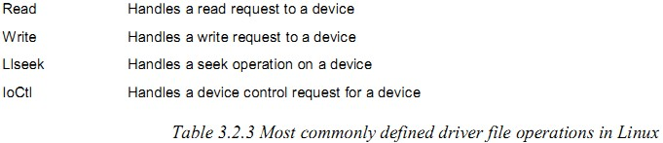
File operations (Linux)
File_operations:

Slide 36
Drive Architecture Components (Linux)
Driver Initialization
Device naming
File operations
How Driver Major Minor Numbers work
User to Kernel and Kernel to User Data Transfer Modes in Linux
Linux Driver Installation
Obtaining Driver Usage Information in Linux

Slide 37
How Driver Major Minor Numbers work (Linux)
Since only one driver can register itself to manage a device with a particular major number, the problem is how can a driver manage two devices with the same major number?
Solution: These devices do not register themselves with the kernel, but with the driver that manages them.
A file structure, operation function pointers, etc

Slide 38
Drive Architecture Components (Linux)
Driver Initialization
Device naming
File operations
How Driver Major Minor Numbers work
User to Kernel and Kernel to User Data Transfer Modes in Linux
Linux Driver Installation
Obtaining Driver Usage Information in Linux

Slide 39
User to Kernel and Kernel to User Data Transfer Modes in Linux
Three ways:
Buffered I/O
Data is copied by the kernel from user space to a kernel space buffer before it’s used inside a driver
Direct I/O
Drivers can read and write data to and from user space buffers directly (through kiobuf interface)
Mmap
Drvier map a chunk of kernel memory to used space using mmap kernel calls s.t aplicationa can perform I/O to the mapped kernel memory

Slide 40
Drive Architecture Components (Linux)
Driver Initialization
Device naming
File operations
How Driver Major Minor Numbers work
User to Kernel and Kernel to User Data Transfer Modes in Linux
Linux Driver Installation
Obtaining Driver Usage Information in Linux

Slide 41
Linux Driver Installation
Transfer the drive files into a system specific directory
Module loading and uploading is performed using programs that come with the kernel module utilities package called insmod, modprobe and rmmod.

Slide 42
Drive Architecture Components (Linux)
Driver Initialization
Device naming
File operations
How Driver Major Minor Numbers work
User to Kernel and Kernel to User Data Transfer Modes in Linux
Linux Driver Installation
Obtaining Driver Usage Information in Linux

Slide 43
Obtaining Driver Usage Information in Linux
The proc file system is used to publish kernel information for application usage.
The proc file system is a communication medium for applications and kernel components (instead of disk storage).

Slide 44
Driver architecture in two OS compared
Driver in both OS have initialization and de-initialization routines, in Lunix, both these routines can have custom names. In Windows, the initialization routine is fixed (DriverEntry), but and de- initialization routine can be a custom name.

Slide 45
Driver architecture in two OS compared
Both OS require drive to implement standard I/O routines, which are called routines in Windows and file operations in Linux.
In Windows, dispatch routines are defined once in the DriverEntry routine inside a driver object, and operate on device objects and IRPs
In Linux, file operations are provided for each device handle returned to an application, and operate on a file structure.
Custom global driver data is stored in device objects in Windows and in the file structure in Linux

Slide 46
Driver architecture in two OS compared
Drivers in Windows are named using driver-defined strings and are found in the \\device namespace, in Linux, drivers are given textual names but applications are not required to know these, driver identification is performed through the use of a major-minor number pair.

Slide 47
Driver architecture in two OS compared
Windows use an INF file to install driver, and the driver will automatically loaded by the PnP manager when the device is present in the system.
In Linux, programs are used to load driver binary image into the kernel. Entries need to be inserted manually into system start up files, so that driver loading programs like modprobe are executed with a driver image path or an alias to the driver as a parameter.

Slide 48
Organization
General driver architecture of the two OS
Driver architecture components of each OS
Implementation of a Driver that performs I/O to a kernel buffer
Driver development environments and facilities offered by the two OS to dvelopers

Slide 49
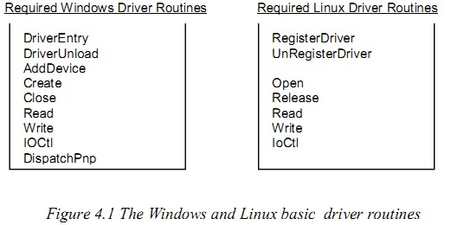
Implementation of a Driver that performs I/O to a kernel buffer
Required Driver components when implement the read, write and IOCTL driver routines in both OS.

Slide 50
Implementation of a Driver that performs I/O to a kernel buffer

Slide 52
Conclusion (driver architectures)
The two operation systems’ driver architectures are different in many ways but have some similarities.
Windows has a more developed architecture than that of Linux, this does not mean that the Windows architecture offers better functionality than that of Linux, rather it has a more formally defined driver model, which drivers developers are encouraged to follow.

Slide 53
Conclusion (driver architectures)
No formally defined driver model exists for the Linux operating system, Linux driver writers produce drivers based on their own personal designs. Drivers from different developers cannot operate together under the Linux system unless they work together. While drivers from two or more sets of developers can be made to work together if they both follow the Windows Driver Model.

Slide 54
Conclusion (design device drivers)
Driver functionality on both OS can be broken up into module, which can be stacked together and that communicate using a standardised data structure, which, under Windows, is IRP, and under Linux it can be any driver-defined structure, since no standardised structure exists on that operating system.

Slide 55
Thank you!

Slide 56
Questions?

